Slide 1
Introduction to ML
Classification Models

Slide 2
Agenda for this week
Introduction to classification
Various classification models
Supervised
Decision Trees
Random Forests
Gradient Boosting
Unuspervised
Clustering
Other important learning as Data Scientists
Familiarity with various IDEs – JupyterNotebook, PyCharm, Spyder, etc.
Code repositories - Kaggle, GitHub
Code deployment – Heroku, AWS, etc.
Project 3
Applications
Evaluation
Overview

Slide 3
Introduction to Classification

Slide 4
Classification: Definition
Given a collection of examples (training set )
Each example is represented by a set of features, sometimes called attributes
Each example is to be given a label or class
Find a model for the label as a function of the values of features.
Goal: previously unseen examples should be assigned a label as accurately as possible.
A test set is used to determine the accuracy of the model. Usually, the given data set is divided into training and test sets, with training set used to build the model and test set used to validate it.
4

Slide 5
Supervised vs. Unsupervised Learning
Supervised learning (classification)
Supervision: The training data (observations, measurements, etc.) are accompanied by labels indicating the class of the observations
New data is classified based on the training set
Unsupervised learning (includes clustering)
The class labels of training data is unknown
Given a set of measurements, observations, etc. with the aim of establishing the existence of classes or clusters in the data
5

Slide 6



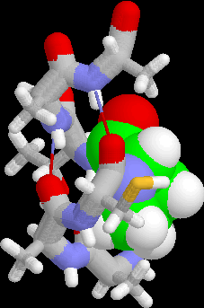
Examples of Classification Tasks
Predicting tumor cells as benign or malignant
Classifying credit card transactions as legitimate or fraudulent
Classifying secondary structures of protein as alpha-helix, beta-sheet, or random
coil
Categorizing news stories as finance, weather, entertainment, sports, etc
6

Slide 7

Illustrating Classification Task
Tid | Attrib1 | Attrib2 | Attrib3 | Class
1 | Yes | Large | 125K | No
2 | No | Medium | 100K | No
3 | No | Small | 70K | No
4 | Yes | Medium | 120K | No
5 | No | Large | 95K | Yes
6 | No | Medium | 60K | No
7 | Yes | Large | 220K | No
8 | No | Small | 85K | Yes
9 | No | Medium | 75K | No
10 | No | Small | 90K | Yes
Learning algorithm
Induction
Learn Model
10
Training Set
Model
Apply Model
Tid | Attrib1 | Attrib2 | Attrib3 | Class
11 | No | Small | 55K | ?
12 | Yes | Medium | 80K | ?
13 | Yes | Large | 110K | ?
14 | No | Small | 95K | ?
15 | No | Large | 67K | ?
Deduction
10
Test Set
7

Slide 8
Classification Techniques
There are a number of different classification algorithms to build a model for classification
Decision Tree based Methods
Rule-based Methods
Memory based reasoning, instance-based learning
Neural Networks
Genetic Algorithms
Naïve Bayes and Bayesian Belief Networks
Support Vector Machines
In this introduction, we illustrate classification tasks using Decision Tree methods
Features can have numeric values (continuous) or a finite set of values (categorical/nominal), including boolean true/false
8

Slide 9
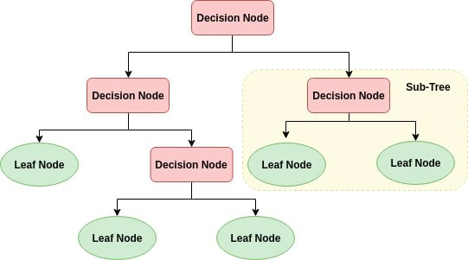
Decision Tree Algorithm
Notes:
The time complexity of decision trees is a function of the number of records and number of attributes in the given data.

Slide 10
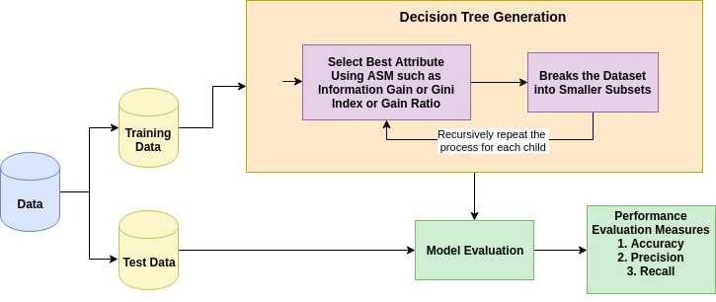
Decision Tree Algorithm
Notes:
The basic idea behind any decision tree algorithm is as follows:
Select the best attribute using Attribute Selection Measures(ASM) to split the records.
Make that attribute a decision node and breaks the dataset into smaller subsets.
Starts tree building by repeating this process recursively for each child until one of the condition will match:
All the tuples belong to the same attribute value.
There are no more remaining attributes.
There are no more instances.

Slide 11
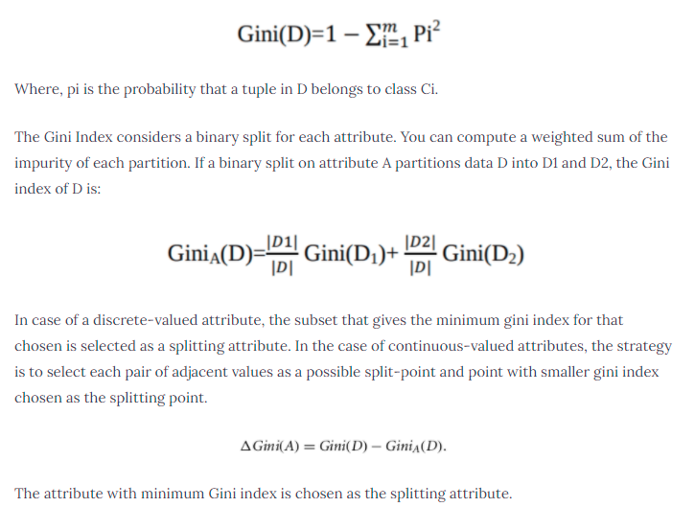
Attribute Selection Measures
Attribute selection measure is a heuristic
Information Gain
Gain Ratio
Gini index
Notes:
Attribute selection measure is a heuristic for selecting the splitting criterion that partition data into the best possible manner.

Slide 12
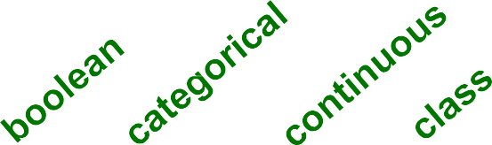
Example of a Decision Tree
Tid | Refund | Marital Status | Taxable Income | Cheat
1 | Yes | Single | 125K | No
2 | No | Married | 100K | No
3 | No | Single | 70K | No
4 | Yes | Married | 120K | No
5 | No | Divorced | 95K | Yes
6 | No | Married | 60K | No
7 | Yes | Divorced | 220K | No
8 | No | Single | 85K | Yes
9 | No | Married | 75K | No
10 | No | Single | 90K | Yes
Refund
Yes
No
NO
MarSt
Single, Divorced
Married
TaxInc
NO
< 80K
> 80K
NO
YES
10
Training Data
Model: Decision Tree
Example task: Given the marital status, refund status, and taxable income of a
person, label them as to whether they will cheat on their income tax.
7

Slide 13
Apply Model to Test Data
Start from the root of tree. Test Data
Refund | Marital Status |  |  | Taxable Income | Cheat
No | Married |  | 80K |  | ?
Refund
Yes
No
10
NO
MarSt
Single, Divorced
Married
TaxInc
NO
< 80K
> 80K
NO
YES

Slide 14
Apply Model to Test Data
Test Data
Refund | Marital Status |  |  | Taxable Income | Cheat
No | Married |  | 80K |  | ?
Refund
Yes
No
10
NO
MarSt
Single, Divorced
Married
TaxInc
NO
< 80K
> 80K
NO
YES

Slide 15
Apply Model to Test Data
Test Data
Refund | Marital Status |  |  | Taxable Income | Cheat
No | Married |  | 80K |  | ?
Refund
Yes
No
10
NO
MarSt
Single, Divorced
Married
TaxInc
NO
< 80K
> 80K
NO
YES

Slide 16
Apply Model to Test Data
Test Data
Refund | Marital Status |  |  | Taxable Income | Cheat
No | Married |  | 80K |  | ?
Refund
Yes
No
10
NO
MarSt
Single, Divorced
Married
TaxInc
NO
< 80K
> 80K
NO
YES

Slide 17
Apply Model to Test Data
Test Data
Refund | Marital Status |  |  | Taxable Income | Cheat
No | Married |  | 80K |  | ?
Refund
Yes
No
10
NO
MarSt
Single, Divorced
Married
TaxInc
NO
< 80K
> 80K
NO
YES

Slide 18
Apply Model to Test Data
Test Data
Refund | Marital Status |  |  | Taxable Income | Cheat
No | Married |  | 80K |  | ?
Refund
Yes
No
10
NO
MarSt
Single, Divorced
Married
Assign Cheat to “No”
TaxInc
NO
< 80K
> 80K
NO
YES

Slide 19

Decision Tree Classification Task
Tid | Attrib1 | Attrib2 | Attrib3 | Class
1 | Yes | Large | 125K | No
2 | No | Medium | 100K | No
3 | No | Small | 70K | No
4 | Yes | Medium | 120K | No
5 | No | Large | 95K | Yes
6 | No | Medium | 60K | No
7 | Yes | Large | 220K | No
8 | No | Small | 85K | Yes
9 | No | Medium | 75K | No
10 | No | Small | 90K | Yes
Tree Induction algorithm
Induction
Learn Model
10
Model
Decision Tree
Training Set
Apply Model
Tid | Attrib1 | Attrib2 | Attrib3 | Class
11 | No | Small | 55K | ?
12 | Yes | Medium | 80K | ?
13 | Yes | Large | 110K | ?
14 | No | Small | 95K | ?
15 | No | Large | 67K | ?
Deduction
10
Test Set

Slide 20
Evaluating Classification Methods
Accuracy
classifier accuracy: predicting class label
predictor accuracy: guessing value of predicted attribute
Speed
time to construct model (training time)
time to use the model (classification/prediction time)
Robustness: handling noise and missing values
Scalability: efficiency in disk-resident databases
Interpretability
understanding and insight provided by the model
Other measures, e.g. goodness of rules, such as decision tree size or compactness of classification model

Slide 21
Metrics for Performance Evaluation
Focus on the predictive capability of a model
– Rather than how fast it takes to classify or build models, scalability, etc.
Confusion Matrix for a binary classifier (two labels) on test set:
 | PREDICTED CLASS
ACTUAL CLASS |  | Class=Yes | Class=No
 | Class=Yes | a | b
 | Class=No | c | d
a: TP (true positive) b: FN (false negative) c: FP (false positive) d: TN (true negative)

Slide 22
Classifier Accuracy Measures
Another widely-used metric: Accuracy of a classifier M is the percentage of test set that are correctly classified by the model M
_{Accuracy =} a + d ₌ TP + TN a + b + c + d TP + TN + FP + FN
 | Yes - C₁ | No - C₂
Yes - C₁ | a: True positive | b: False negative
No - C₂ | c: False positive | d: True negative
classes | buy_computer = yes | buy_computer = no | total
buy_computer = yes | 6954 | 46 | 7000
buy_computer = no | 412 | 2588 | 3000
total | 7366 | 2634 | 10000

Slide 23
Other Classifier Measures
Alternative accuracy measures (e.g., for cancer diagnosis or information retrieval)
sensitivity = t-pos/pos specificity = t-neg/neg
/* true positive recognition rate */
/* true negative recognition rate */
precision = t-pos/(t-pos + f-pos) recall = t-pos/(t-pos + f-neg )
accuracy = sensitivity * pos/(pos + neg) + specificity * neg/(pos + neg)

Slide 24
Multi-Class Classification
Most classification algorithms solve binary classification tasks, while many tasks are naturally multi-class, i.e. there are more than 2 labels
Multi-Class problems are solved by training a number of binary classifiers and combining them to get a multi-class result
Confusion matrix is extended to the multi-class case
Accuracy definition is naturally extended to the multi-class case
Precision and recall are defined for the binary classifiers trained for each label

Slide 25
Issues with imbalanced classes
Consider a 2-class problem with labels Yes and No
Number of No examples = 990
Number of Yes examples = 10
If model predicts everything to be No, accuracy is 990/1000
= 99 %
Accuracy is misleading because model does not detect any Yes example
Precision and recall will be better measures if you are training a classifier to find rare examples.

Slide 26
Evaluating the Accuracy of a Classifier
Holdout method
Given data is randomly partitioned into two independent sets
Training set (e.g., 2/3) for model construction
Test set (e.g., 1/3) for accuracy estimation
Cross-validation (k-fold, where k = 10 is most popular)
Randomly partition the data into k mutually exclusive
subsets, each approximately equal size
At i-th iteration, use D_{i} as test set and others as training set
1:
2:
. . .
test | train |  |  |  |  | train
 |  |  | train | train
train | test | train | train | train

Slide 27
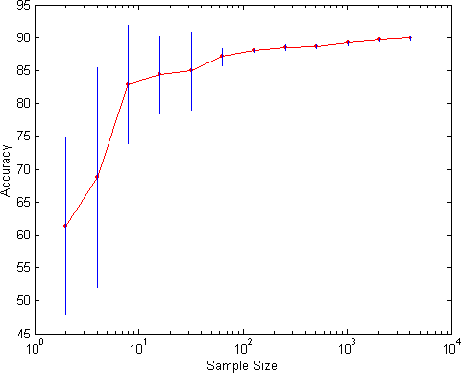
Evaluating the Model - Learning Curve
Learning curve shows how accuracy changes with varying sample size
Requires a sampling schedule for creating learning curve

Slide 28
Classifier Performance: Feature Selection
Too long a training or testing is a performance issue for classification of problems with large numbers of attributes or nominal attributes with large numbers of values
Feature selection techniques aim to reduce the number of features by finding a smaller or minimal set that can accurately classify the problem
reduce the training and prediction time by eliminating noisy or redundant features
Two main types of techniques
Filtering methods apply a statistical or other information measure to the attribute values without running any training and testing
Wrapper methods try different combinations of attributes, run cross- validation evaluations and compare the results

Slide 29
Classifier Performance: Ensemble Methods
Construct a set of classifiers from the training data
Predict class label of previously unseen records by aggregating predictions made by multiple classifiers
Examples of ensemble methods
Bagging
Boosting
Heterogeneous classifiers trained on different feature subsets
sometimes called mixture of experts

Slide 30



General Idea
Original Training data
D
Step 1: Create Multiple
Data Sets
....
D₁
D₂
^{D}t-1
D_{t}
Step 2: Build Multiple
Classifiers
C
1
C
2
C
t -1
C
t
Step 3: Combine Classifiers
_{C}*

Slide 31
Examples of Classification Problems
Some NLP problems are widely investigated as supervised classification problems, and use a variety of problem instances
Text categorization: assigning topic labels to documents
Word Sense Disambiguation: assigning a sense to a word, as it occurs in a document
Semantic Role Labeling: assigning semantic roles to phrases in a sentence
From the NLTK book, chapter 6:
Classify first names according to gender
Document classification (text categorization)
Part-Of-Speech tagging
Sentence Segmentation
Identifying Dialog Act types
Recognizing Textual Entailment

Slide 32
Text Categorization
Represent each document by the words/tokens/terms it contains
Sometimes called unigrams, sometimes bag-of-words
Identify terms from the document text
Remove symbols with little meaning
Remove words with little meaning – the stop words
Stem the meaningful words
Remove endings to get root of the word
– From enchanted, enchants, enchantment, enchanting, get the root word enchant
Group together words into phrases (optional)
Proper names or other words that are likely to have a different meaning as a phrase than the individual words
After grouping, may also want to lowercase the terms

Slide 33
Thank You!

